Slide 1
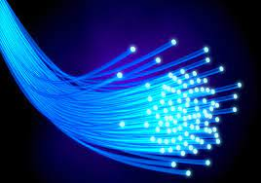

Temporal Solitons in Optical Fibres
Propagation and Dispersion
X THE PLACE OF USEFUL LEARNING
Lewis M Russell | SN: 201817988
PH562 | Presentation Talk
Date | 12/05/2023

Slide 2
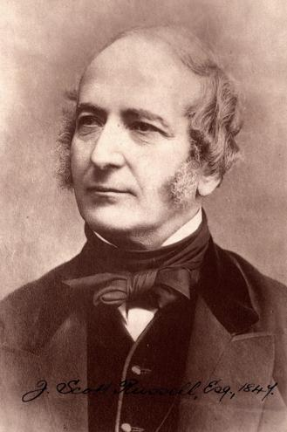
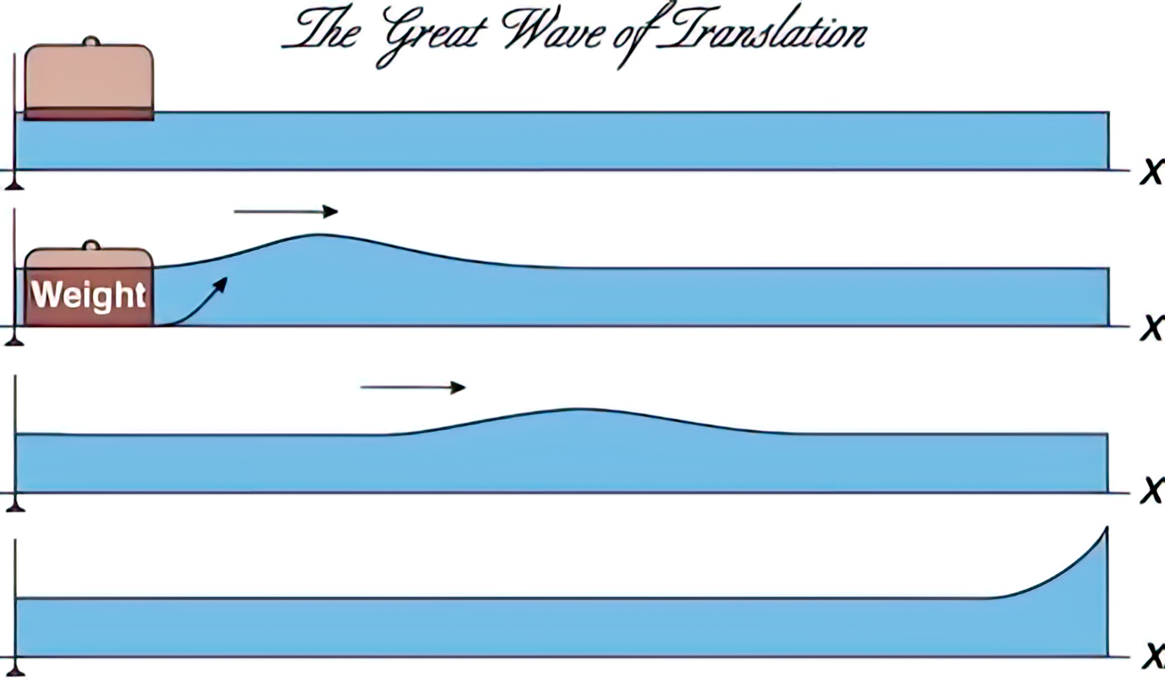
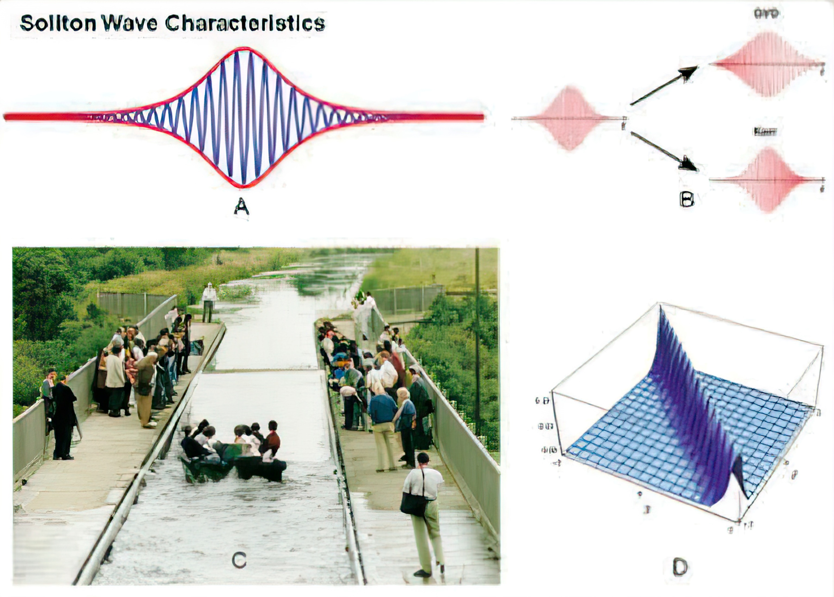
Solitons | Overview
“Waves of Translation”
[1]
First observation by J.S.Russell, 1844
Solitons in NL Dispersive Media formalised in the 1960s by Martin Kruskal and Norman Zabusky
Extended to Optical Fibres in 1973 by Akira Hasegawa and Fumio Tappert
Soltion Wave Characteristics
GVD
[2]
Kerr
[1] Y.R. Shen. (1997). Science. 276. 1520-1520.
[2] Geesink, Hans & Meijer, Dirk. (2017). Electromagnetic Biology and Medicine. 36. 357-378.

Slide 3
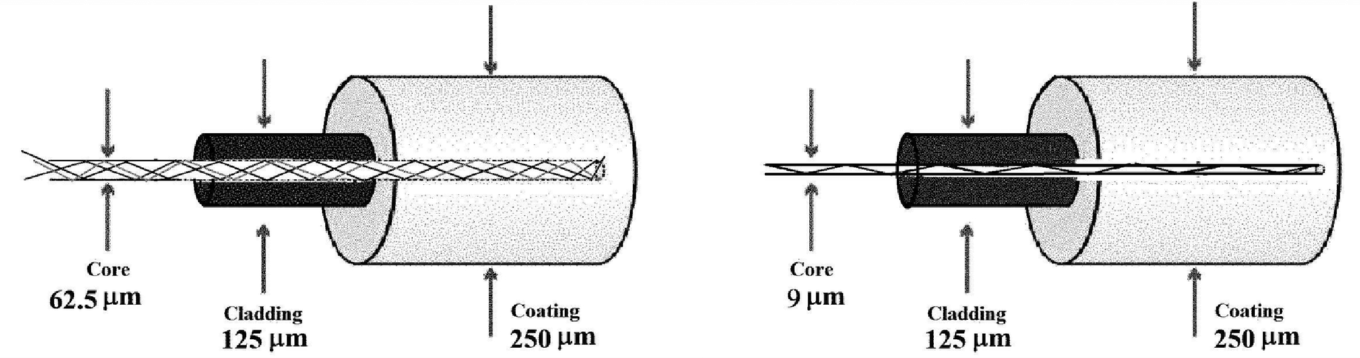

Optical Fibres | Overview
Three Main Fibre Sections:
Core
Cladding
Coating
Light Confined to Core Propagation via Total-Internal-Reflection:
Single-Mode
Fibre (SMF)
$$n_{cladding}<n_{core}$$
Multi-Mode
Fibre (MMF)
Non-Traditional Optical Fibres Exist:
Hollow-Core (HCFs)
Photonic Crystal (PCFs)
Polarisation-Maintaining
Traditional Cladded Fibre Optics
[3] Figure From: Hayat Rezgui. (2022). Global Journal of Science Frontier Research. 21. 14–20.

Slide 4
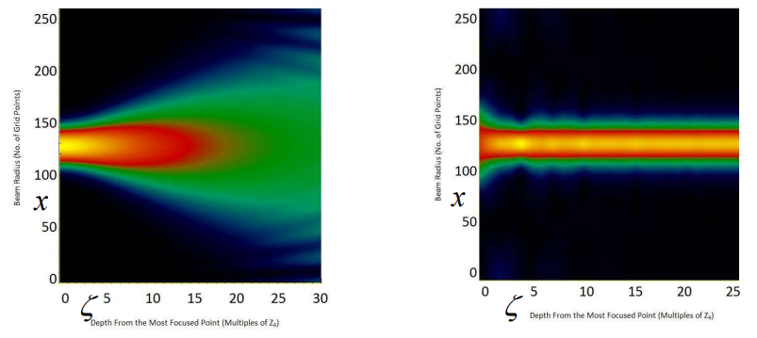
Solitons | Spatial vs Temporal
Spatial
Spatial -> Diffraction
Temporal -> Dispersion
Temporal
Balance nonlinear self-(de)focusing
& linear diffraction effects
Self-guided via transverse confinement in orthogonal directions to their direction of propagation
Again, relies on balanced nonlinear and linear terms.
Linear | Dispersion, via group velocity
Nonlinear | Variations of Phase Velocity as a function of Wave Intensity
Relies on spatial confinement
Linear Case: Diffraction Nonlinear Case: Self-focusing
[4]
[4] Prof. Oppo’s Lecture Slides, PH562. 2023. Slides 15-16

Slide 5
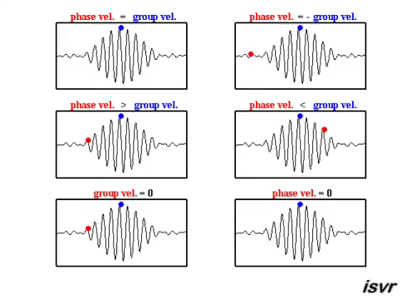


Group Velocity and Phase Velocity
Group Velocity
$$v_{g}=\frac{δω}{δk}$$
[5]
Phase Velocity
$$v_{p}=\frac{ω}{k}=\frac{δx}{δt}$$
[5] .mp4 From:
https://www.reddit.com/r/Physics/comments/4mehf8/best_explanatory_gif_of_phase_velocity_and_group/

Slide 6
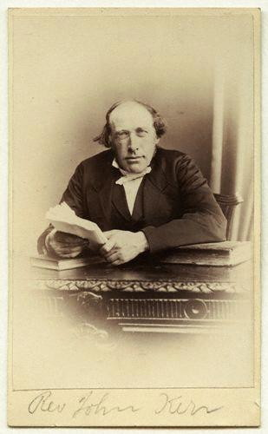
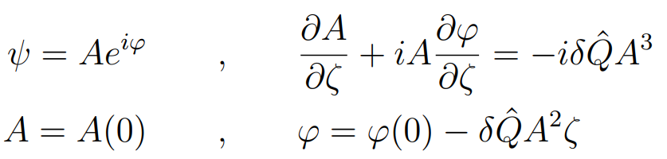
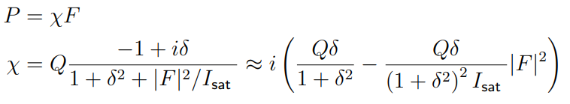
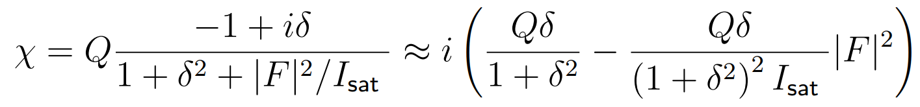
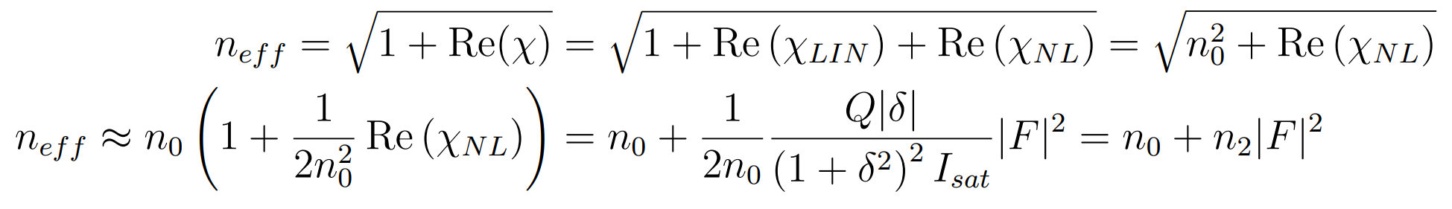
Kerr Nonlinearity
Equations here taken from Lectures 15-16 of the PH562 Course
ψ , the complex envelope of the optical field
A , amplitude | ϕ , phase
Q , NL co-efficient
ζ , distance | δ , detuning
Temporal solitons exclusively arise within Kerr-nonlinearity conforming materials.
Refractive index of material depends on the intensity of the propagating light.
ψ , Polarisation
A , Susceptibility
F , Electric Field
Q , Material Constant
I , Saturation Intensity
H , Light Intensity
n , Refractive Index
= Linear ≈>
= Non-Linear ≈>
= Effective

Slide 7
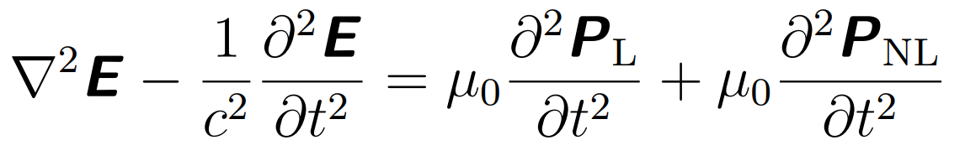
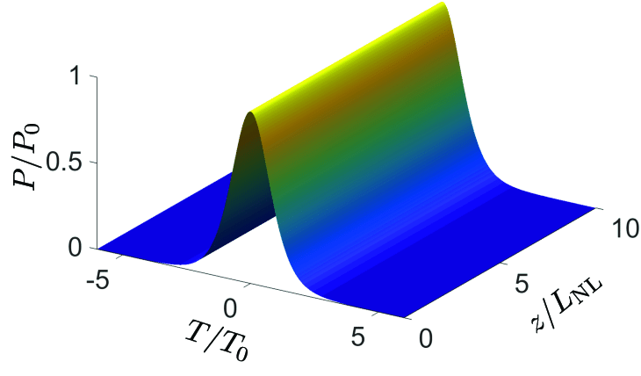
Propagation | NLSE
Perhaps around 100 integrable nonlinear differential equations allowing soliton solutions:
Korteweg–de Vries (KdV), sine-Gordon,…., many more.
NLSE most common.
Other Equations
ψ , group velocity term, accounting for the delay in the envelope
, The group velocity dispersion (GVD) term, pulse spreads due to different GVs of its frequency comp’s.
, The fibre loss term
, NL Kerr term
Maxwell’s EM
Wave Equation
[6]
Considering:
E , Quasi-Monochromatic
Slowly Varying Amplitude (SVA)
Rapidly Oscillating Terms Eliminated
Simple Soliton Example
Nonlinear Schrödinger Equation (NLSE)
[6] Mitschke, Fedor & Mahnke, Christoph & Hause, Alexander. (2017). Soliton Content of Fiber-Optic Light Pulses. Applied Sciences. 7. 635.

Slide 8
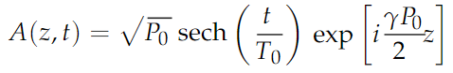
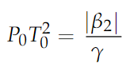
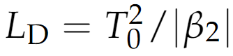
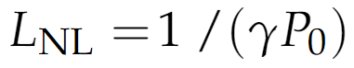
Propagation | NLSE
Equations from: [6] Mitschke, Fedor & Mahnke, Christoph & Hause, Alexander. (2017). Soliton Content of Fiber-Optic Light Pulses. Applied Sciences.
7. 635.
[6]
For Single Soliton:
Amplitude and Duration must be Coupled via:
Without nonlinearity, shape would change appreciably after one dispersion length:
With nonlinearity, length defined as:
Simple Soliton Example
P₀ , Peak power
T₀ , Pulse Duration

Slide 9
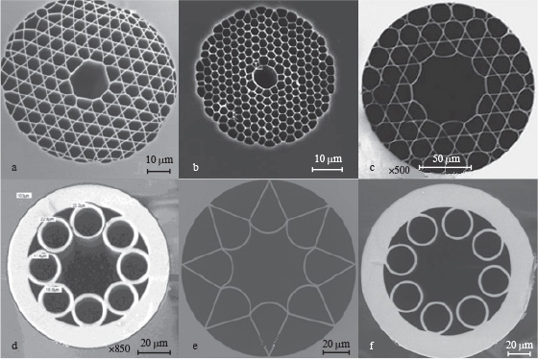
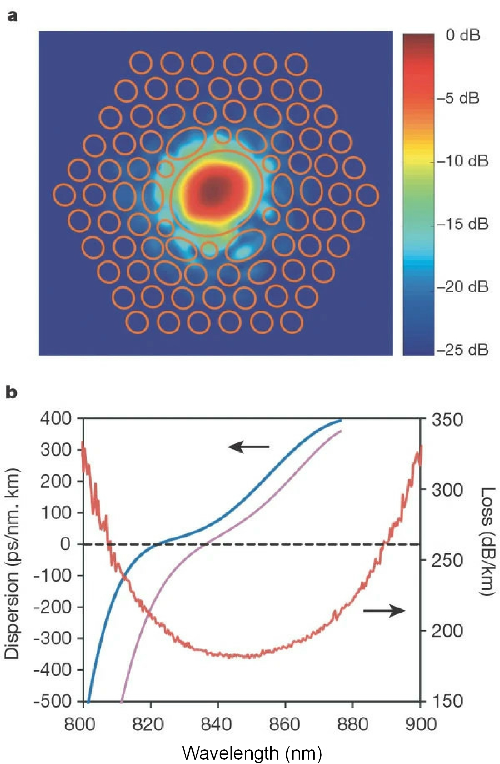
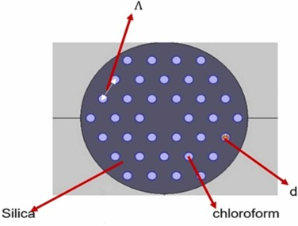
Speciality Fibre Designs
Hollow-Core
Extremely low material absorption & nonlinearity
Lower signal attenuation
Reduced dispersion
Longer transmission distances
Higher data rates
Photonic Crystal
Periodic arrangement of microstructures in cladding
Periodic array of air holes or dielectric inclusions
Highly customisable and tailored dispersion profiles
Polarisation-Maintaining
Specialised PM properties for applications requiring communication of photon polarisation over fibre-optics
Measured Properties of an Example HC-PCF around 850nm
Cross-Sectional Electron-Microscopy:
a, b, c, HC-PCFs;
d, e, f, Revolver-type HC fibres.
Chloroform Clad-filled
Temperature-Invariant PCF

Slide 10
In Summary...
Small Presentation……… Big Topic
Kerr-Nonlinearity and NLSE focus, relates best to PH562 Course Material
Further Reading:
My PH562 Essay | https://github.com/lrussell676/Public_Yr_5_Files/blob/main/PH562_Essay_Lewis_Russell.pdf
(Non-referenced figures within this presentation can be found and cited with my essay)
This PH562 Presentation | https://github.com/lrussell676/Public_Yr_5_Files/blob/main/PH562_Talk_Lewis_Russell.pptx

Slide 11
X THE PLACE OF USEFUL LEARNING

